Slide 1
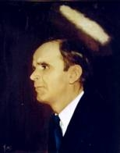

110
OH, IT IS JESUS
Oh, it is Jesus! Yes, it is Jesus!
It is Jesus in my soul;
For I have touched the hem of His garment,
And His blood has made me whole.

